Slide 1
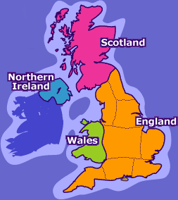
Read the following weather forecast and then draw the suitable symbols on the map:
Rain is possible especially in the Southeast of England, cloudy skies in Wales and clear skies in the rest of the United Kingdom. Very strong winds from the Northeast in Wales and light winds from the North in England and Scotland.

Slide 2
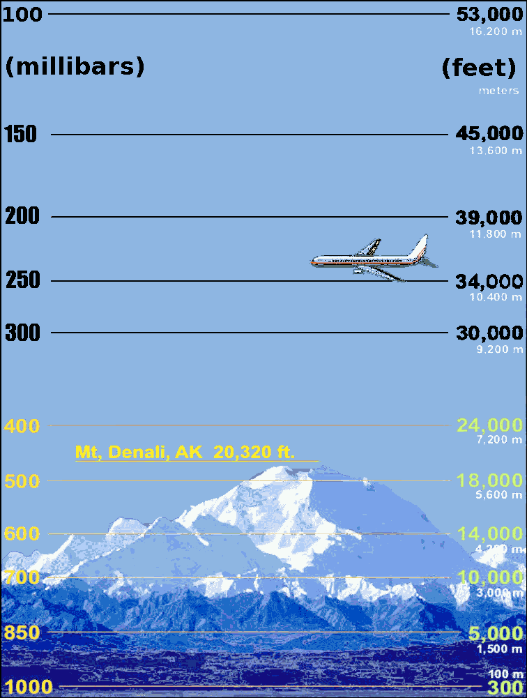
Atmospheric pressure

Slide 3
Atmpospheric pressure is the force exerted by the weight of the air on the Earth’s surface

Slide 4
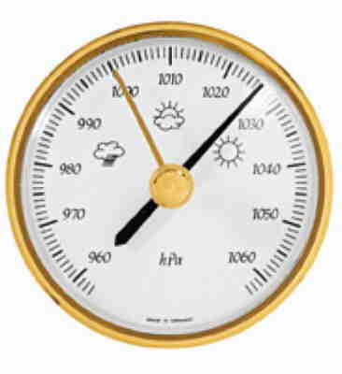
Atmospheric pressure is useful to forecast (predecir) the state of the sky

Slide 5
ATMOSPHERIC PRESSURE by Violeta

Slide 6
What is the normal value of pressure?

Slide 7
What is the normal value of pressure? 1015 milibars (mb)

Slide 8
What is the normal value of pressure? 1015 milibars (mb)
1033 mb

Slide 9
What is the normal value of pressure? 1015 milibars (mb)
1033 mb

Slide 10
What is the normal value of pressure? 1015 milibars (mb)
1000 mb

Slide 11
What is the normal value of pressure? 1015 milibars (mb)
1000 mb

Slide 12
What is the normal value of pressure? 1015 milibars (mb)
980 mb

Slide 13
What is the normal value of pressure? 1015 milibars (mb)
980 mb

Slide 14
What is the normal value of pressure? 1015 milibars (mb)
1015 mb

Slide 15
What is the normal value of pressure? 1015 milibars (mb)
1015 mb

Slide 16
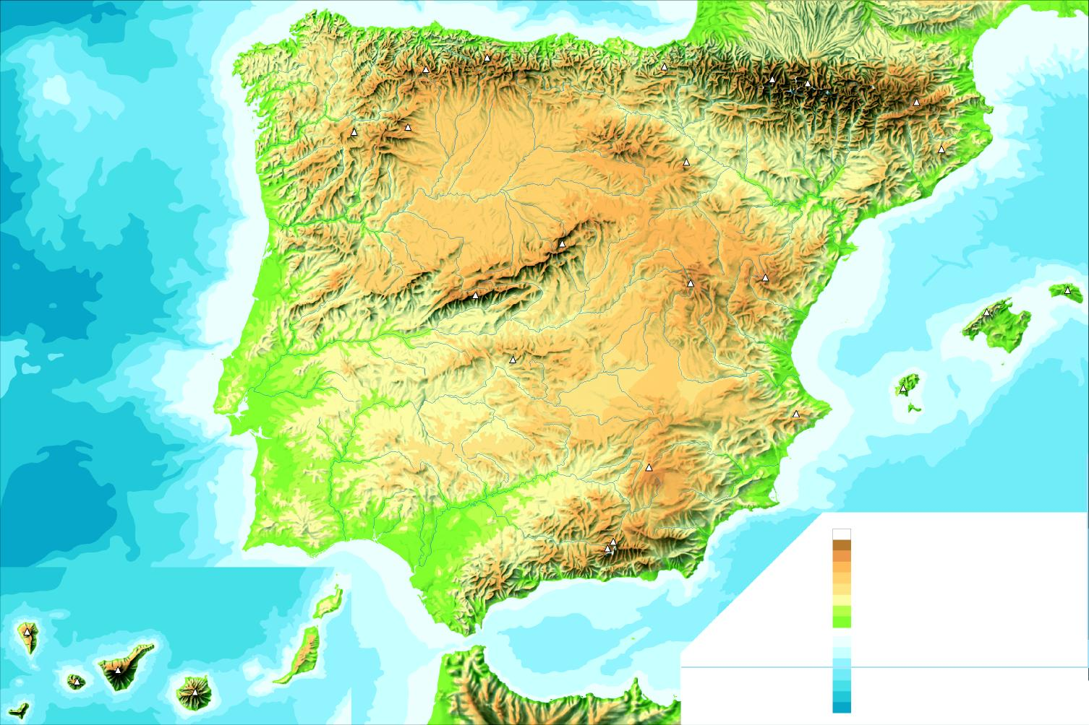
1000
996
1004
992
1008
1012
1016
1012
1016
1020
1032
1028

Slide 17
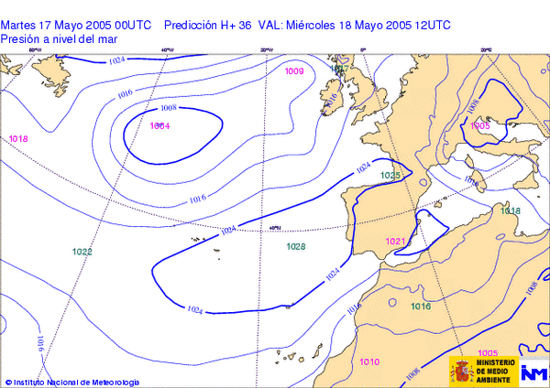
Isobars show atmospheric pressure

Slide 18
Isobar map
1000 mb

Slide 19
Isobar map
1000 mb
998 mb
1004 mb

Slide 20
Isobar map
A
1000 mb
E
998 mb
c
B
D
1004 mb
F

Slide 21
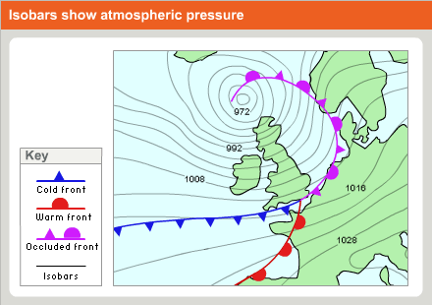
Mapa de isobaras para identificar el estado del cielo

Slide 22
Mapa de isobaras para identificar el estado del cielo
Baja presión
Low pressure
Borrasca
Cyclon
Alta presión
High pressure
Anticiclón
Anticyclon

Slide 23
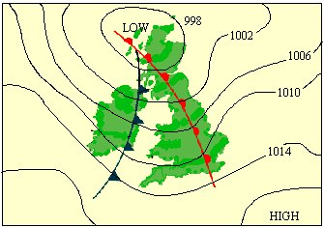

Slide 24
Wind direction from the isobar map
1000 mb
998 mb
1004 mb

Slide 25
Wind direction from the isobar map
1000 mb
998 mb
1004 mb

Slide 28
Wind speed from the isobar map
1000
1004
1008
1016

Slide 29
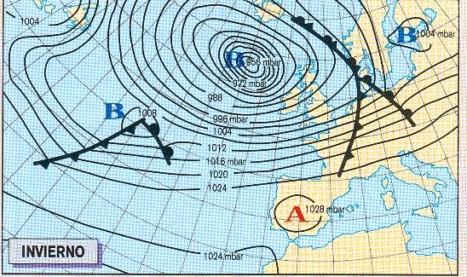
Mapa 1

Slide 30
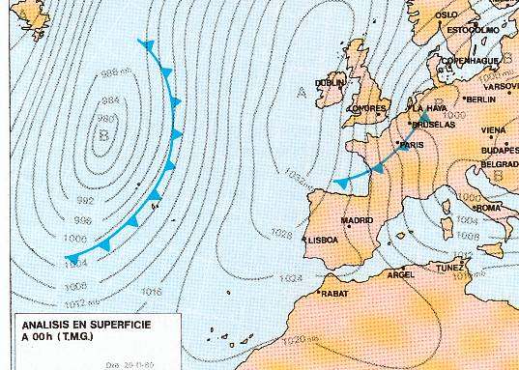
Mapa 5

Slide 31
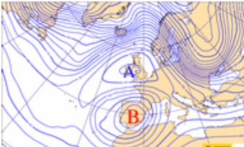

Slide 32
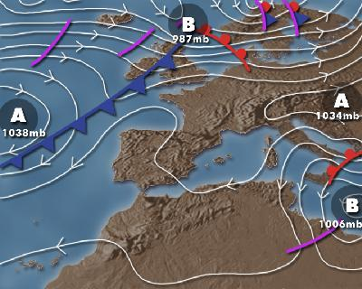

Slide 33
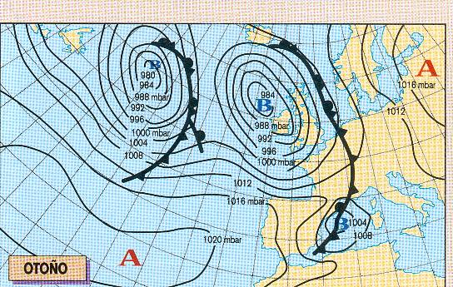
Mapa 4

Slide 34
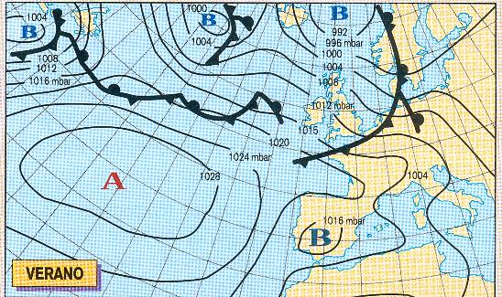
Mapa 2

Slide 35
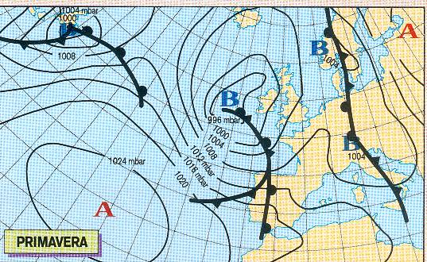
Mapa 3

Slide 36
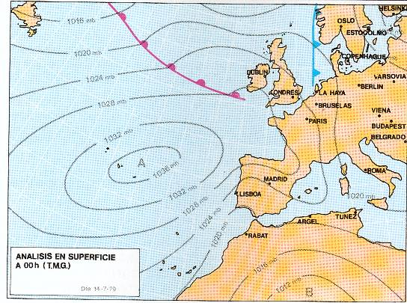
Mapa 6

Slide 37
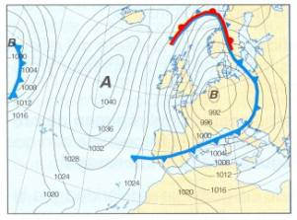

Slide 38
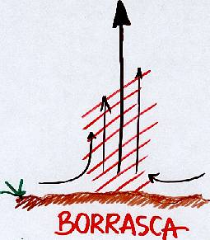
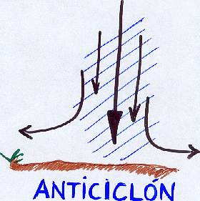
Notes:
En los lugares que asciende el aire, disminuye la presión originando un centro de bajas presiones o borrascas (B). Hay inestabilidad y se suelen producir precipitaciones.
En los lugares en que el aire desciende, aumenta la presión originando un centro de altas presiones o anticiclón (A). Hay estabilidad y suele hacer buen tiempo.

Slide 39
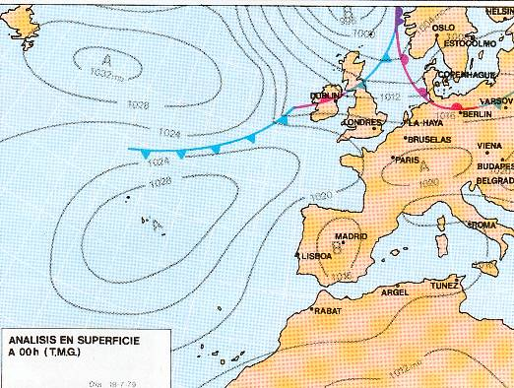
Mapa 7

Slide 40
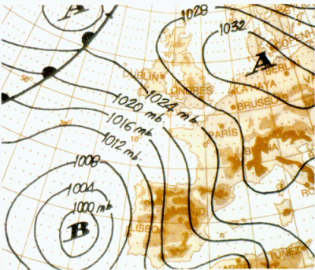

Slide 41
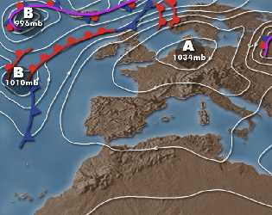

Slide 42
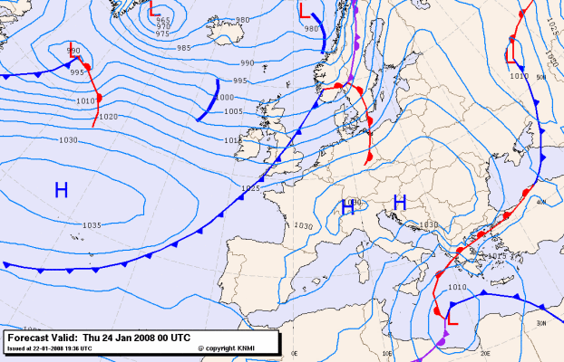

Slide 43
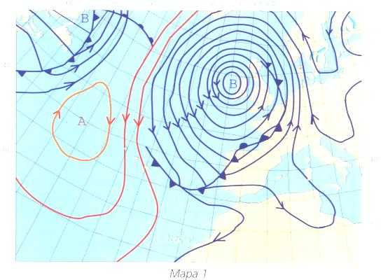

Slide 44
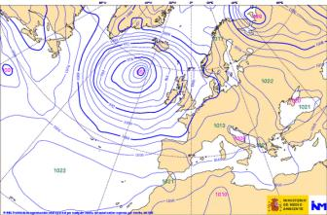

Slide 45
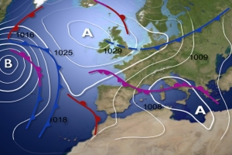

Slide 46
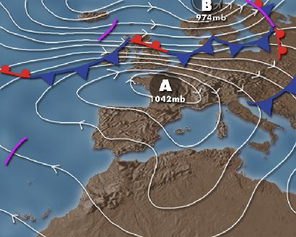

Slide 48
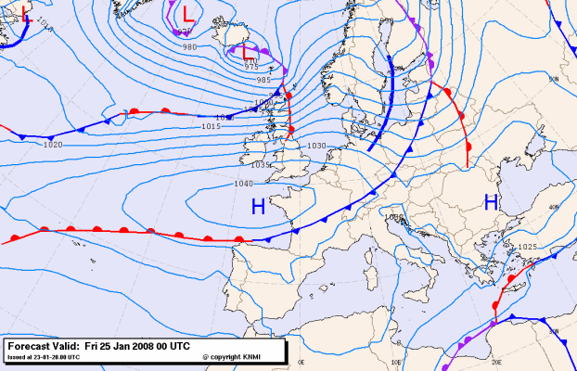

Slide 49
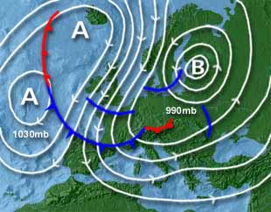

Slide 50
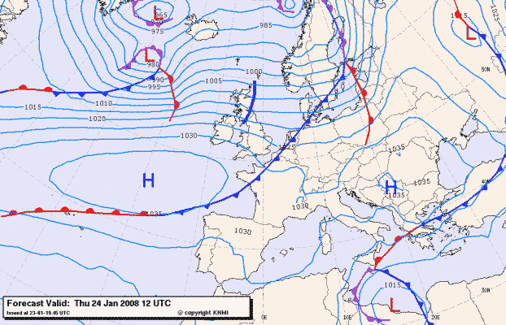

Slide 51
