Slide 1
LA PRÁCTICA DOCENTE EN CENTROS BILINGÜES

Slide 2
What is bilingual teaching?
Looking for on-line resources.
Planning educational lessons.
Task work in class.
Sharing time.

Slide 3


Slide 4
Lesson plans.
Presentations.
Worksheets, labsheets.
Animations and simulations
Videos.
Podcast.
Quizzes.
Interactive websites.

Slide 5
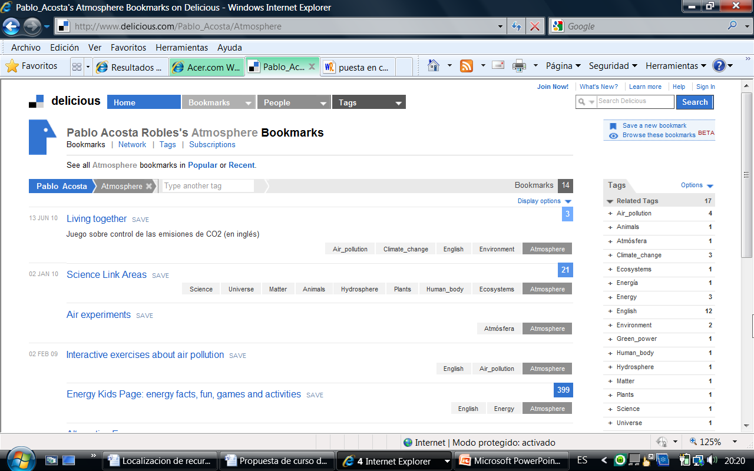

Slide 6
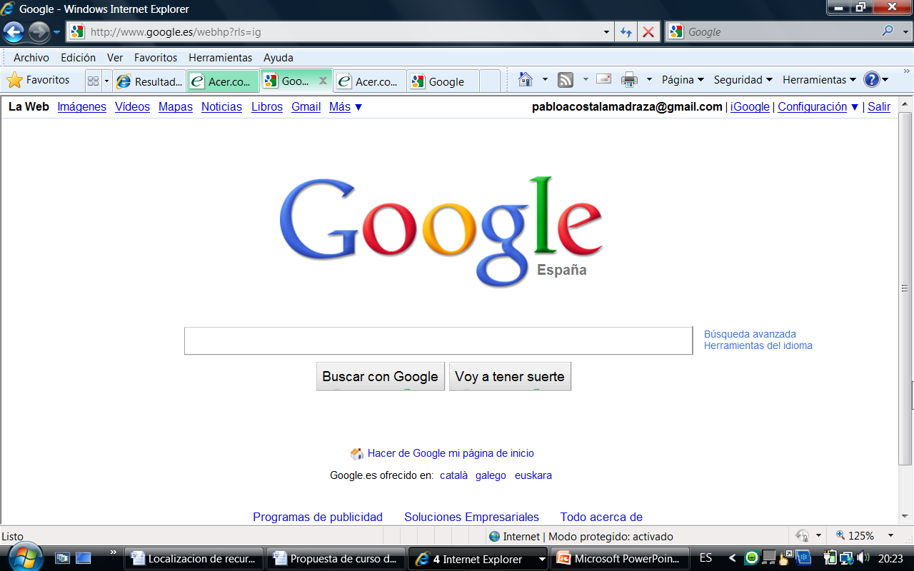

Slide 7
“Plant reproduction”

Slide 8
“Plant reproduction” worksheet

Slide 9
“Plant reproduction” worksheet KS3

Slide 10
ESPAÑA | UNITED KINGDOM |  |  |  | USA & Australia
6º Prim. | Year 7 | Form 1 | Secondary | Key Stage 3 KS3
1ºESO | Year 8 | Form 2 |  |  | Grade 7 | K-7
2ºESO | Year 9 SAT exam | Form 3 |  |  | Grade 8 | K-8
3ºESO | Year 10 | Form 4 |  | Key Stage 4 KS4 | Grade 9 | K-9
4ºESO | Year 11 GCSE Exam | Form 5 |  |  | Grade 10 | K-10
1ºBach. | Year 12 | Sixth Form or A-level |  | Key Stage 5 KS5 | Grade 11 | K-11
2ºBach. | Year 13 GCE Exam |  |  |  | Grade 12 | K-12

Slide 11
1.Lesson plans.
BBC for teachers.
http://www.bbc.co.uk/schools/teachers/
Science-class.net.
http://www.schoolsnet.com/pls/hot_school/sn_lessons.page_pls_show_lessons?x=16180339&p_subj_id=8
Ministerio de Educación del Reino Unido.
http://www.teachernet.gov.uk/teachingandlearning/resourcematerials/Resources/

Slide 12
2.Presentations or slideshows.
Slideshare.
http://www.slideshare.net/
Google:
Plant reproduction filetype:ppt

Slide 13
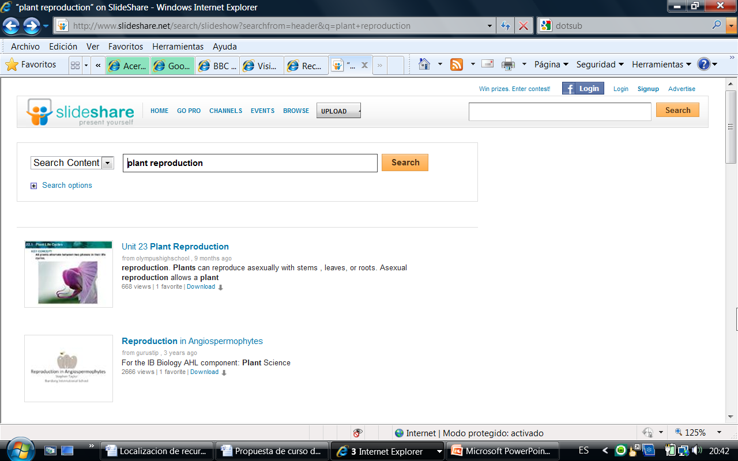

Slide 14
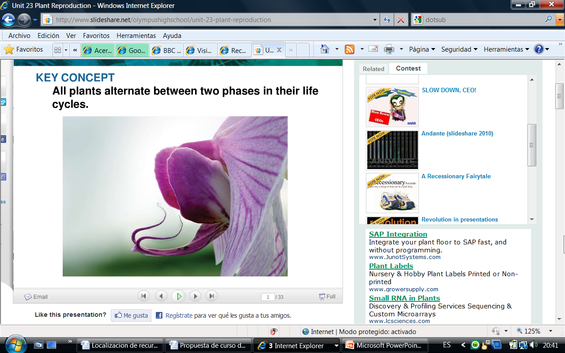

Slide 15
3.Worksheet and labsheet.
Science-class.net.
http://www.science-class.net/
Enchanted learning
http://www.enchantedlearning.com/Home.html
Teaching ideas and resources (U.K.).
http://www.teachingideas.co.uk/

Slide 16
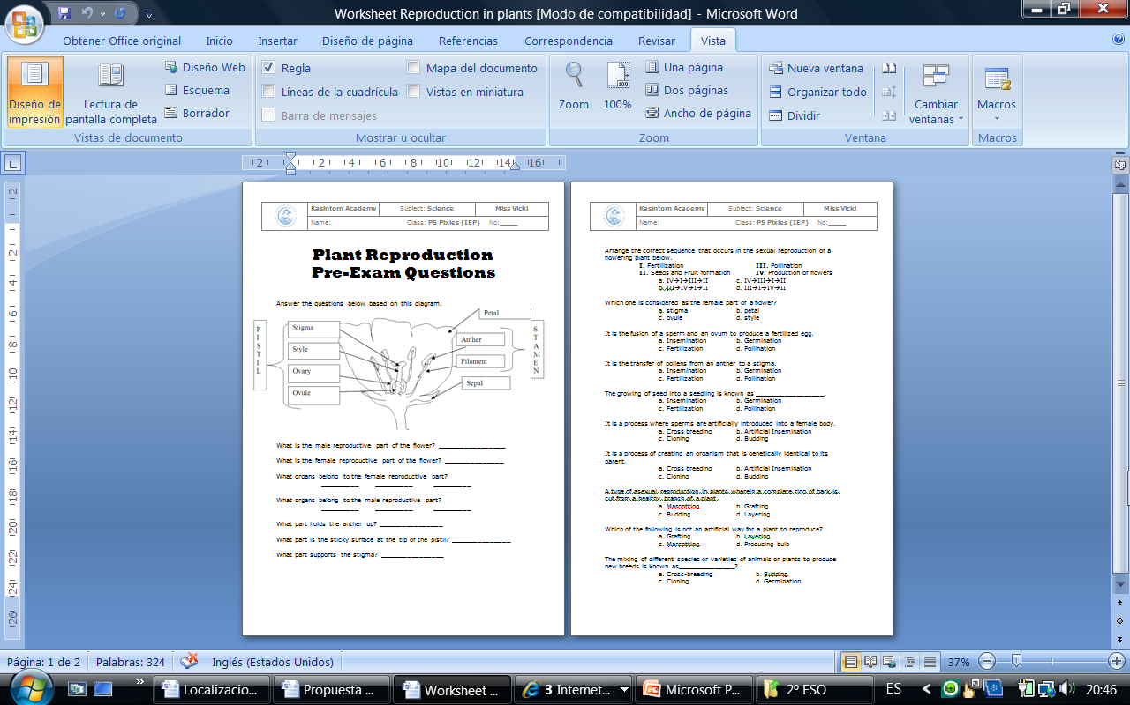

Slide 17
4.Animaciones y simulaciones interactivas.
BBC-KS2-BITESIZE (play, read and quiz).
http://www.bbc.co.uk/schools/ks2bitesize/science/
BBC-KS3-BITESIZE (Revise, Activity, Test).
http://www.bbc.co.uk/schools/ks3bitesize/
SKOOOL.
http://kent.skoool.co.uk/keystage3.aspx?id=63

Slide 18
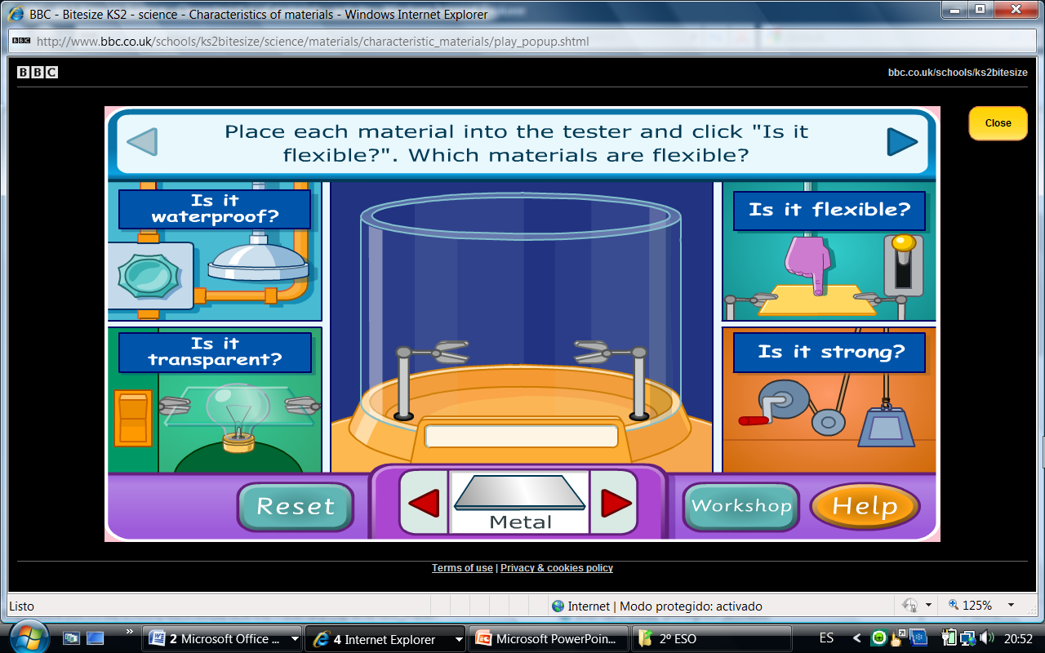

Slide 19
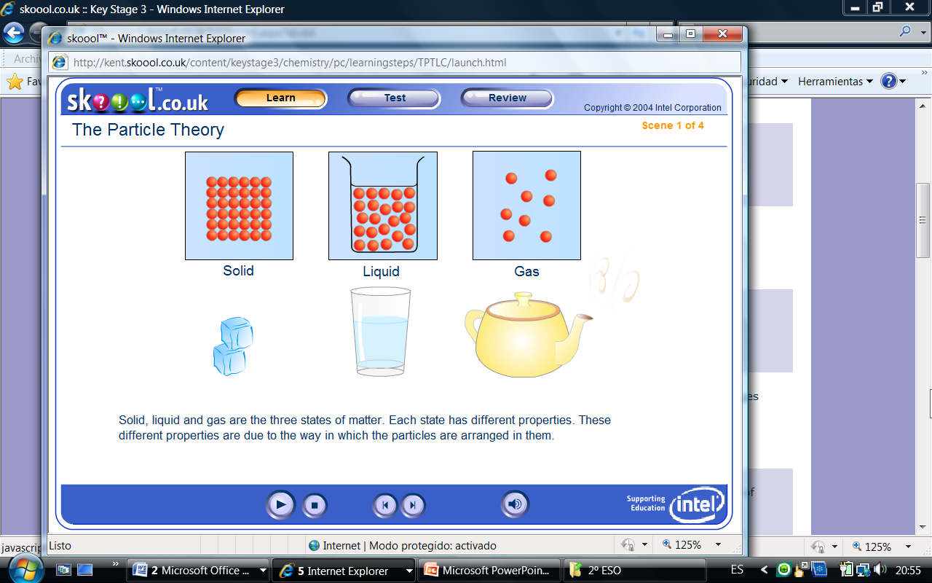

Slide 20
5.Vídeos.
Youtube
Video clips from BBC programmes on Learning Zone
http://www.bbc.co.uk/learningzone/clips/
Elearning for kids.
http://www.e-learningforkids.org/index.html
Videos from teachertube.
http://www.teachertube.com/
Dotsub.
http://dotsub.com/

Slide 21
6.Podcasts
7.Quizzes
Quizzes from FUN TRIVIA and from KWIZNET.
http://www.funtrivia.com/quizzes/index.cfm
http://www.kwiznet.com/p/mykwizNET.php
GLENCOE.
http://glencoe.mcgraw-hill.com/sites/0078600499/student_view0/self-check_quizzes.html
http://glencoe.mcgraw-hill.com/sites/0078600499/student_view0/brainpop_movies.html#

Slide 22
8.Otras páginas web.
Natural History Museum.
http://www.nhm.ac.uk/kids-only/fun-games/mission-explore/index.html
Earth learning idea.
http://geophysics.esci.keele.ac.uk/earthlearningidea/English/contents_alphabet.html
The human body.
http://www.bbc.co.uk/science/humanbody/
http://www.visiblebody.com/
Banco de materiales de Linguared.
http://ulises.cepgranada.org/moodle/mod/resource/view.php?id=7395

Slide 23
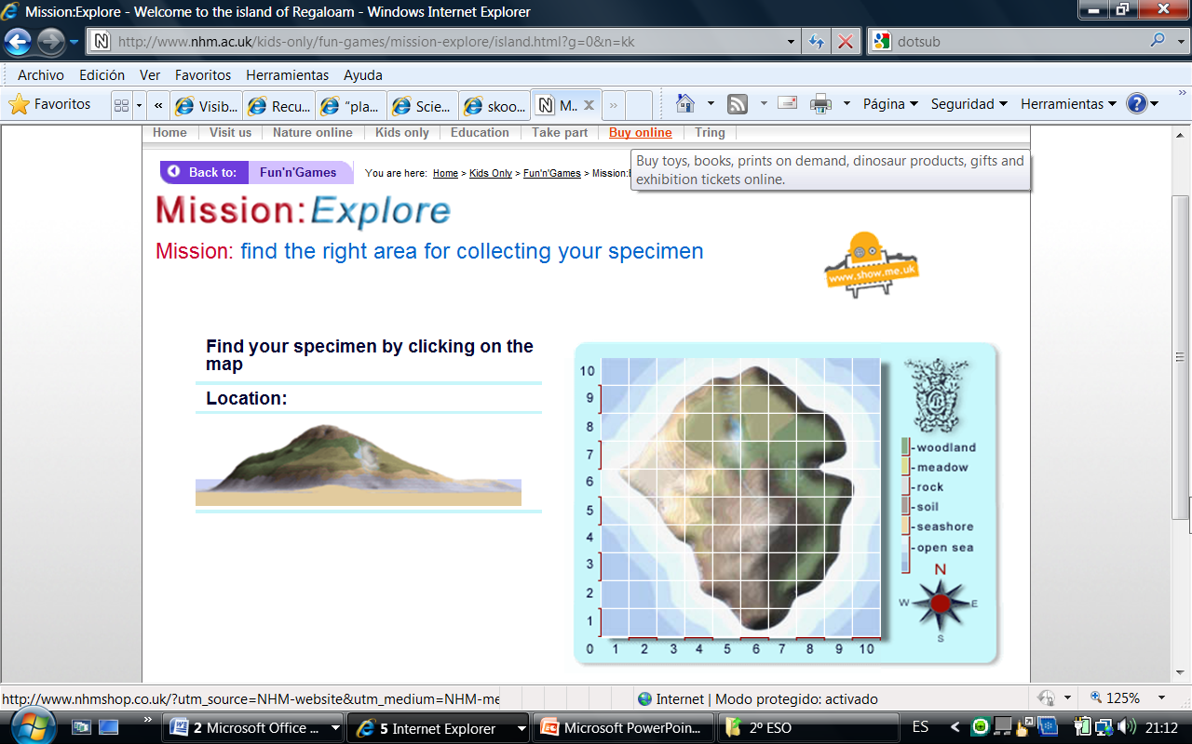

Slide 24
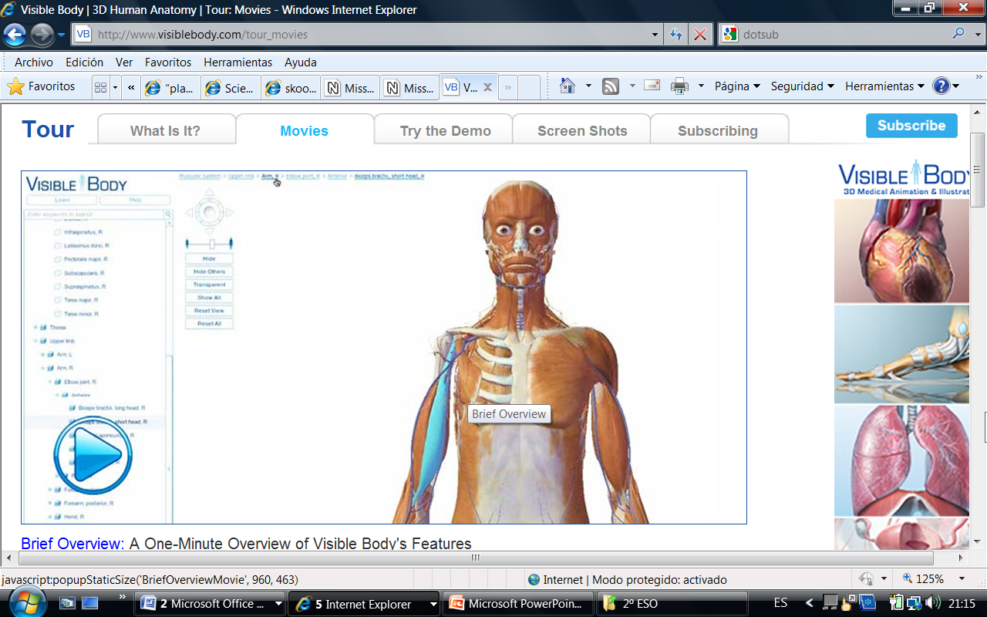

Slide 25
8.Otras páginas web.
Natural History Museum.
http://www.nhm.ac.uk/kids-only/fun-games/mission-explore/index.html
Earth learning idea.
http://geophysics.esci.keele.ac.uk/earthlearningidea/English/contents_alphabet.html
The human body.
http://www.bbc.co.uk/science/humanbody/
http://www.visiblebody.com/
Banco de materiales de Linguared.
http://ulises.cepgranada.org/moodle/mod/resource/view.php?id=7395

